Slide 1
D&B Country Risk - Economic Overview of Malaysia
Presented by: Paula Carney, Market Manager & Development Leader D&B Ireland
November 2012

Slide 2
Content
D&B-170 Years of Information
Risk Snapshot-Malaysia Nov 2012
Positive & Negative Risk Factors
Current Climate & Recommendation on Trading
World Risk View
2
Notes:
2
2

Slide 3
D&B-170 Years of Information
Dun & Bradstreet (NYSE:DNB) is the world's leading source of commercial information and insight on businesses, enabling companies to Decide with Confidence® for 170 years. D&B's global commercial database contains more than 205 million business records. The database is enhanced by D&B's proprietary DUNSRight® Quality Process, which provides our customers with quality business information. This quality information is the foundation of our global solutions that customers rely on to make critical business decisions.
D&B provides solution sets that meet a diverse set of customer needs globally. Customers use D&B Risk Management Solutions™ to mitigate credit and supplier risk, increase cash flow and drive increased profitability; D&B Sales & Marketing Solutions™ to increase revenue from new and existing customers; and D&B Internet Solutions™ to convert prospects into clients faster by enabling business professionals to research companies, executives and industries, over the web
September 2009 saw D&B purchase a domestic business information company called ICC and moving forward with an investment of over $150 million dollars into the Irish Market Place.
D&B now employs over 200 people in various functions from Global R&D, Data and Operations, Linkage Experts and highly experienced Sales and Marketing Team.
For many years Irish businesses have utilised Business Information from a myriad of sources to justify the granting of credit, D&B over the past few years have taken the ability to “Decide with Confidence” to a new level introducing to the market, the premise of adopting Value Added Solutions to drive commercial decisioning.
Notes:
Talk through –spend about 2 mins on this-Share insight to country risk, Explore IDA investment and our good news story.

Slide 4
My Connections to Malaysia
Notes:
Deborah Henry- My cousin and Miss Malaysia Universe and World –Twice none the less-Degree in Political Science and Economics.

Slide 5
Risk Snapshot of the Malaysian Economic Position Nov 2012
Despite weak Global demand, some positive signs have been seen recently for the Malaysian economy
Exports grew 2.6% (y/y) in September to MYR60.21bn, recovering from the 4.5% y/y contraction in the previous mo nth.
Electrical and electronics exports , which were 35.4% of Septembers total grew 4.8% y/y
Exports to neighbouring ASEAN countries( now Malaysia's largest trading partners and accounting for 27.3% of total trade for January –September) expanded 18.9% y/y offsetting shipments to China and EU (which contracted 10.8% and 2.2% y/y respectively
Robust domestic demand has helped the Malaysian economy avoid a slowdown.
New vehicle sales continued to rise by a healthy 3.3% y/y to 45,872 units in September
Vehicle production expanded by 11.8% from a year earlier
Industrial production rose by 4.9% y/y in September
Manufacturing output and electricity production was up by 5.2% and 5.9% y/y respectively- This contrasts with slowing factory output figures from other export reliant economies in regions such as Singapore and Thailand .This suggest that domestic demand remains firm against the negative external backdrops.
Elevated Government spending ahead of next years national election will continue to support growth as it did in the first half of the year.

Slide 6
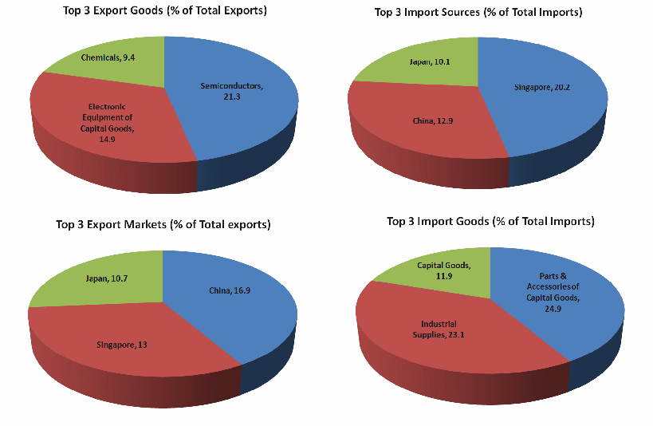
Real GDP Growth, %

Slide 7
Positive and Negative Risk Factors
Malaysia has maintained an impressive rate of economic growth in recent decades via the development of FDI –led export industries, notably in the electronics/IT sectors.
CPI rose by 1.3% y/y in September, the slowest pace in two years.
Given low inflation and resilient domestic demand, Bank Negara Malaysia held its policy on interest rate which remained un-changed at 3% for the ninth straight month in October-making it the only monetary authority in Southeast Asia that has not eased its benchmark rate this year.
One potential threat and risk factor for the economy stems from the possibility that growth will come under pressure once public spending tails off after next years election.
D&B is maintaining Malaysia's country risk rating at a satisfactory DB3b for now. However should exports deteriorate again and domestic demand fail to keep up, then a downward move of one level within the DB3 risk band may be considered before mid 2013
7
Notes:
Negative risk factors in Malaysia-
The looming election presents political risk. Indeed, the fractious opposition may make significant gains, especially if the economy slows.
Despite an ostensible reform drive, the government still adheres to repressive measures, and relies on repackaged ethno-centric and state-led policies in order to bolster growth.
Export growth is being led by commodities rather than traditional electronic goods, but the former are increasingly dependent on sustained Chinese demand.
Household debt levels are rising rapidly; this could pose a risk if interest rates climb more than expected.
Thailand Negative Risk Factors-
Despite improved stability, Thailand’s political environment remains deeply polarised.
Currency appreciation caused by still-strong growth and rising interest rates could weaken export competitiveness. Inflation is also a major source of risk.
A sharper than expected downturn in the global economy (in light of growing sovereign debt problems in Europe and of the withdrawal of fiscal stimulus measures) will force downward revisions in our forecast scenario.
Corruption is a problem and regulatory uncertainty over the application of environmental laws is still hindering investment in the Map Ta Phut industrial zone.
7

Slide 8
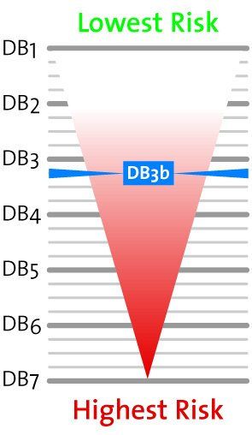
Malaysia-Current Climate and recommended trading terms
DB3b-There is enough uncertainty over expected returns to warrant close monitoring of this country, suppliers should actively manage their risk exposure-Risk is considered moderate risk. The trend is considered stable, the country's overall risk profile has not changed even though some minor changes to its political, economic and external risk environments may have occurred
Trade Terms
Minimum Terms-Sight Draft
Recommended Terms-Letter of Credit
Usual Terms-30-90 days
Transfer Situation
Local Delays-0-1 month
FX/Bank Delays 0-1 month
Export Credit Agencies
US Eximbank-Full cover available, restrictions apply
Atradius-Full cover available
ECGD-Full cover available
Euler Hermes UK-Full ST cover available
Notes:
The central bank’s measures aimed at cooling property market speculation will also dampen activity: households are already reporting greater difficulties in obtaining mortgage loans, which will almost certainly prompt the residential construction sector to slow. Indeed, it is to be hoped that the government keeps back some fiscal fire
power for counter-cyclical investment spending in the September budget: it may well be needed
D&B believes that the fact that an official election date has still not been set reflects the BN’s rising concerns over its electoral prospects. Indeed, we expect that Prime Minister Najib Razak is likely to use the late September 2013 budget speech to shower fresh populist give-aways on voters in order to win back their favour, with the election likely to follow soon after.
Point 2-However, this strategy is risky. The electorate is increasingly sophisticated and able to see through such obvious bribes. At the same time, a major corruption scandal relating to USD190m of bribes paid alongside a USD1.1bn state purchase of submarines from a French firm (as well as a linked murder) when Najib was defence minister is snowballing and already dragging down his close associates.

Slide 9
GDP & Inflation

Slide 11
D&B World Risk Map
Notes:
Something to think about-When we look at the map at the particular areas we trade in we see that is is marked as Amber-A risk to be considered, when we look at our own country and see the indicator as amber-Do we consider our market the same risk-Dealing in any market considered god or bad always has an element of risk-What we do with this knowledge and how we manage the possible risk, allows risk to be turned to lucrative opportunity..The markets we discussed today have amble opportunity and growth-manage the risk appropriately and the opportunity is all yours!

